Slide 1
TEAM Evaluation and School Libraries
Judy Bivens, MLS, Ed D
and
Ruth Kinnersley, MLS, Ed D
Trevecca Nazarene University

Slide 2
Purpose of the Study
TEAM evaluation – new process for all Tennessee school instructional personnel
(more than one evaluation model used in TN)
Wanted to know how TASL’s members were prepared for the elements on which they were evaluated
Used Survey Monkey; emailed TASL membership via listserv
Survey opened 2/12-8/12
Responses 5/7/12-6/30/12—note # not evaluated 5 full; 6 part

Slide 3
Demographics of the Study
Responses: 82 (10% of 800+ members)
School Level (numbers are approximate):
Elementary – 44
Middle/Junior High School – 24
High School – 22
NOTE: This adds up to 90, indicating that at least
8 librarians are covering a larger grade range.

Slide 4
Demographics of the Study
Counties represented: 73 responses
33 counties
Some may not have responded because they don’t work for a “county” system
East Tennessee: 15 (18%)
Middle Tennessee: 45 (55%)
West Tennessee: 22 (27%)

Slide 5
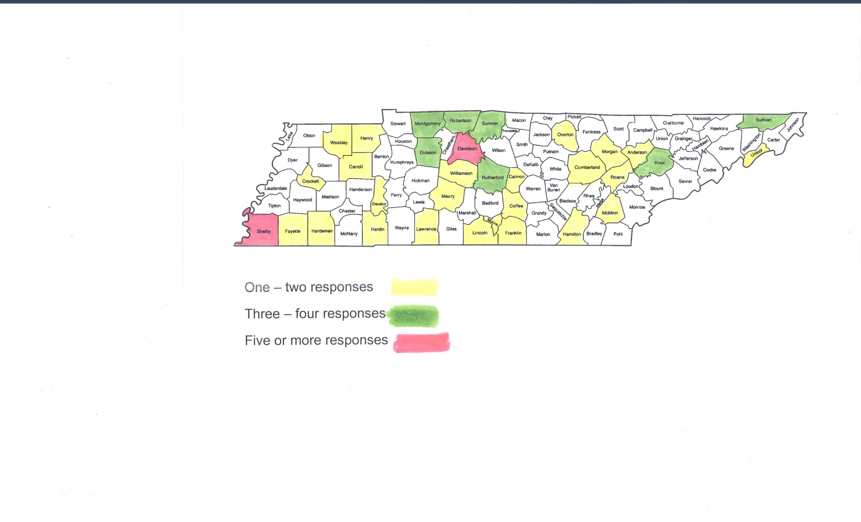

Slide 6
Demographics of the Study
Years since finished MLIS
Less than 5 years – 19 (23%)
More than 5 years – 63 (77%)

Slide 7
Demographics of the Study
Degree:
M.Ed. with endorsement in library - 45 (55%)
Masters with all courses in library science - 37 (45%)
Other (Error) -
Bachelor’s degree in library science – 5
Other graduate work with LIS endorsement - 2

Slide 8
Average Scores
Planning 4.3 N= 70 (66+4)
Environment 4.2 N= 69 (66+3)
Instruction 3.9 N= 70 (66+4)
Not evaluated: 5 full; 6 part
One respondent was library administrator – did the evaluations
No scores yet/na: 4

Slide 9
Areas for Refinement: Planning
Media Center Management-9
Media Center Resources-9
Media Center Collaboration—25
Planning 4.3

Slide 10
Area for Refinement: Planning Comments on Collaboration
“Hard to do when I am not given any time or included in teacher’s meetings”
“Create a plan for documentation of student achievement”
“Develop a variety of literacy activities that reaches all learners”
“Explore thematic subject area support”
“Work on science collection to support CCS

Slide 11
Area of Refinement: Environment
Expexctations-6
Managing Student Behavior-10
Environment-18
Respectful Culture-11
Environment 4.2

Slide 12
Area of Refinement: Environment Comments
“Display student work”
“Involve students more in—feedback, leading class, rule setting”
“Incentives for behavior”
“More contact with students”
“Encourage student independence in research”

Slide 13
Area of Refinement: Instruction-
Standards-2
Motivating-2
Presenting Content-0
Lesson Pacing-6
Activities-2
Questioning-13
Academic Feedback-2
Monitoring-4
LMS knowledge-1
Knowledge of students-10
Thinking-3
Info Lit-0
Collaboration-2
Instruction 3.9

Slide 14
Area of Refinement: Instruction- Comments-Knowledge of Student
“Differentiate more”
“Use data to assess student interest and performance to improve resources and instruction”
“Meeting the needs of all students (i.e. inclusion)
“Use more formative assessment”
“Use Exit Tickets” (Could also be Objective)

Slide 15
Area of Refinement: Instruction- Comments on Questioning
“Higher order questions”
“Ask more questions and work on questioning skills”
“Wait time”
Use Bloom’s Taxonomy”
“Call on more non-volunteers”

Slide 16
Area of Reinforcement: Planning
Media Center Management-9/12
Media Center Resources-9/8
Media Center Collaboration—25/14
Planning 4.3

Slide 17
Area of Reinforcement: Planning Comments-
“Variety of promotional activities”
“Protocols are in place to help with media center needs”
“Library is best state of organization, productivity, efficiency in the history of our building”
“Open library has encouraged constant use and ownership by students and adults”
“Weekly PLC’s to analyze and discuss student data”

Slide 18
Area of Reinforcement: Environment
Expexctations-6/11
Managing Student Behavior- 10/4
Environment-18/14
Respectful Culture-11/11
Environment 4.2

Slide 19
Area of Reinforcement: Environment Comments
“Continue to welcome all members and guests”
“Librarian has created a warm, welcoming media center that is the heart of instruction in our school”
“Receptive to student interests and opinions”
“Librarian shows respect for all students”
“Well organized, designated areas, welcome environment where all students feel safe”

Slide 20
Area of Reinforcement: Instruction
Standards-2/8
Motivating-2/6
Presenting Content-0/1
Lesson Pacing-6/6
Activities-2/5
Questioning-13/6
Academic Feedback-2/0
Monitoring-4/0
LMS knowledge-1/11
Knowledge of students-10/2
Thinking-3/3
Info Lit-0/4
Collaboration-2/2
Instruction 3.9

Slide 21
Area of Reinforcement: Instruction-Comments
“Uses a variety of activities and materials”
“Consistently incorporates lessons from school curricula”
“Strong objectives, formative assessment”
“Excellent job modeling thought process”
“Uses technology and media center resources to provide activities that help students recognize importance of learning”

Slide 22
“My principal knew enough about what I do to evaluate me adequately”
Strongly Disagree – 9 11%
Disagree - 19 23%
Neutral - 20 24%
Agree - 25 31%
Strongly Agree - 9 11%
Comments: 38

Slide 23
“My principal knew enough about what I do to evaluate me adequately”
Comments:
Principal did not evaluate me – 9
I was evaluated with teacher evaluation/like a classroom teacher – 5
Principal was not trained on library rubric – 4
Principal knows they don’t know - 3
Principal learned from what I gave him/her – 3
Principal was surprised/overwhelmed w/ what I do - 2
Did not get copies of my evaluations/scores - 2

Slide 24
“The evaluation tool adequately represents my school library program.”
Strongly Disagree - 9 11%
Disagree - 29 35%
Neutral - 24 29%
Agree - 17 21%
Strongly Agree - 3 4%
Comments: 32

Slide 25
“The evaluation tool adequately represents my school library program.”
Comments:
The evaluation tool asks for too much to be covered in one lesson – 2
Portfolio should be a larger part of evaluation – 3
One indicated it should be the 15% professionalism piece
Tool does not allow for differences among grade
levels – high school vs. elementary
“I do so much more than is indicated on this tool”

Slide 26
“The evaluation process will help me be a better librarian.”
Strongly Disagree - 11 13%
Disagree - 24 29%
Neutral - 21 26%
Agree - 24 29%
Strongly Agree - 2 2%
Comments: 38

Slide 27
“The evaluation process will help me be a better librarian.”
Comments:
Too much work/takes away from my regular duties – 9
Made me more stressed, not better - 6
Not implemented well by my supervisor – 5
It pushed me to meet instructional objectives and
look at how I teach – 5
“My entire evaluation was basically made up”
It was a “Dog and Pony Show”

Slide 28
“ The university from which I graduated prepared me adequately for the items under Planning on which I was evaluated.”
Strongly Disagree - 4 5%
Disagree - 9 11%
Neutral - 18 22%
Agree - 38 46%
Strongly Agree - 13 16%
Comments: 29

Slide 29
“ The university from which I graduated prepared me adequately for the items under Planning on which I was evaluated.”
Comments:
My university prepared me to be a media specialist, not a bureaucrat
My degree was too long ago – this wasn’t envisioned then/planning has really changed
No, but I have learned on the job over the years
That whole process that was supposedly “new” was taught to me 30 years ago
Comments that they were well prepared, named instructors at their institutions
Evaluated with classroom teacher form – so No

Slide 30
“ The university from which I graduated prepared me adequately for the items under Environment on which I was evaluated.”
Strongly Disagree - 3 4%
Disagree - 10 12%
Neutral - 17 21%
Agree - 36 44%
Strongly Agree - 16 20%
Comments: 15

Slide 31
“ The university from which I graduated prepared me adequately for the items under Environment on which I was evaluated.”
Comments:
There was no discussion of environment when the dinosaurs roamed and I was in school
I have learned more through my ongoing professional development and job experience
Some comments that they did feel their university prepared them well
Some comments that “Environment” is not library science; but education

Slide 32
“ The university from which I graduated prepared me adequately for the items under Instruction on which I was evaluated.”
Strongly Disagree - 6 7%
Disagree - 17 21%
Neutral - 18 22%
Agree - 33 40%
Strongly Agree - 8 9%
Comments: 22

Slide 33
“ The university from which I graduated prepared me adequately for the items under Instruction on which I was evaluated.”
Comments:
My Elem. Ed. degree provided more info than MLIS degree (many comments about this distinction)
Instruction was not covered in my library degree
Instruction rubric for librarians is completely unrealistic
Don’t know students well enough to differentiate
Doesn’t allow for checkout during the class period
My primary purpose is not to teach in the library
We did more of the “why” than the “how” in my coursework. Had to develop specifics on my own

Slide 34
Based on your experiences, what can MLIS programs do to better prepare you for today’s school library culture?
Instruction!!

Slide 35
Based on your experiences, what can MLIS programs do to better prepare you for today’s school library culture? Instruction!
Of responses that actually contained suggestions, well over half related to instruction.
Lesson plans
Standards-aligning CCS and AASL
Assessment
Collaboration
Differentiation, especially exceptional ed
Classroom management/motivation

Slide 36
Feedback from you
Have you been assessed on the Professionalism Rubric?
How did that transpire?
Environment
Planning
Instruction
Professionalism

Slide 37
Wrap-up
Questions?
Contact info:
rkinnersley@trevecca.edu
jbivens@trevecca.edu
Comments?

